Slide 1
Create and present an ER diagram for an Online Library System, explaining each component clearly
CSA05_CO1_TECHNICAL PRESENTATION
Presented by
M. V. Preethashri(192524476)
Under supervision of
Dr. J. Ruby Elizabeth

Slide 2
Introduction
Online Library System
Digital platform for managing library operations.
Stores books and member information.
Automates borrowing and returning.
Reduces manual paperwork.

Slide 3
Objectives
Manage books efficiently.
Maintain member records.
Track book borrowing and returns.
Generate accurate library reports.

Slide 4
ER Diagram EXPLAIN
Represents database structure visually.
Shows entities and relationships.
Helps in database design.
Improves system organization

Slide 5
Main Entities
Book
Member
Librarian
Loan
Author
Publisher

Slide 6
Attributes of Book
Attribute | Description
Book_ID (PK) | Unique Book ID
Title | Book Name
ISBN | ISBN Number
Category | Book Category
Availability | Available/Issued

Slide 7
Attributes of Member
Attribute | Description
Member_ID (PK) | Unique Member ID
Name | Member Name
Email | Email Address
Phone | Contact Number
Address | Residential Address

Slide 8
Other Entities
Librarian
Librarian_ID
Name
Email
Author
Author_ID
Author_Name
Publisher
Publisher_ID
Publisher_Name
Loan
Loan_ID
Issue_Date
Return_Date
Fine

Slide 9
Relationships
Member borrows Book
Librarian issues Book
Author writes Book
Publisher publishes Book
Loan records transactions

Slide 10
Cardinality
One Member → Many Loans
One Book → Many Loans
One Author → Many Books
One Publisher → Many Books
One Librarian → Many Loan Records

Slide 11
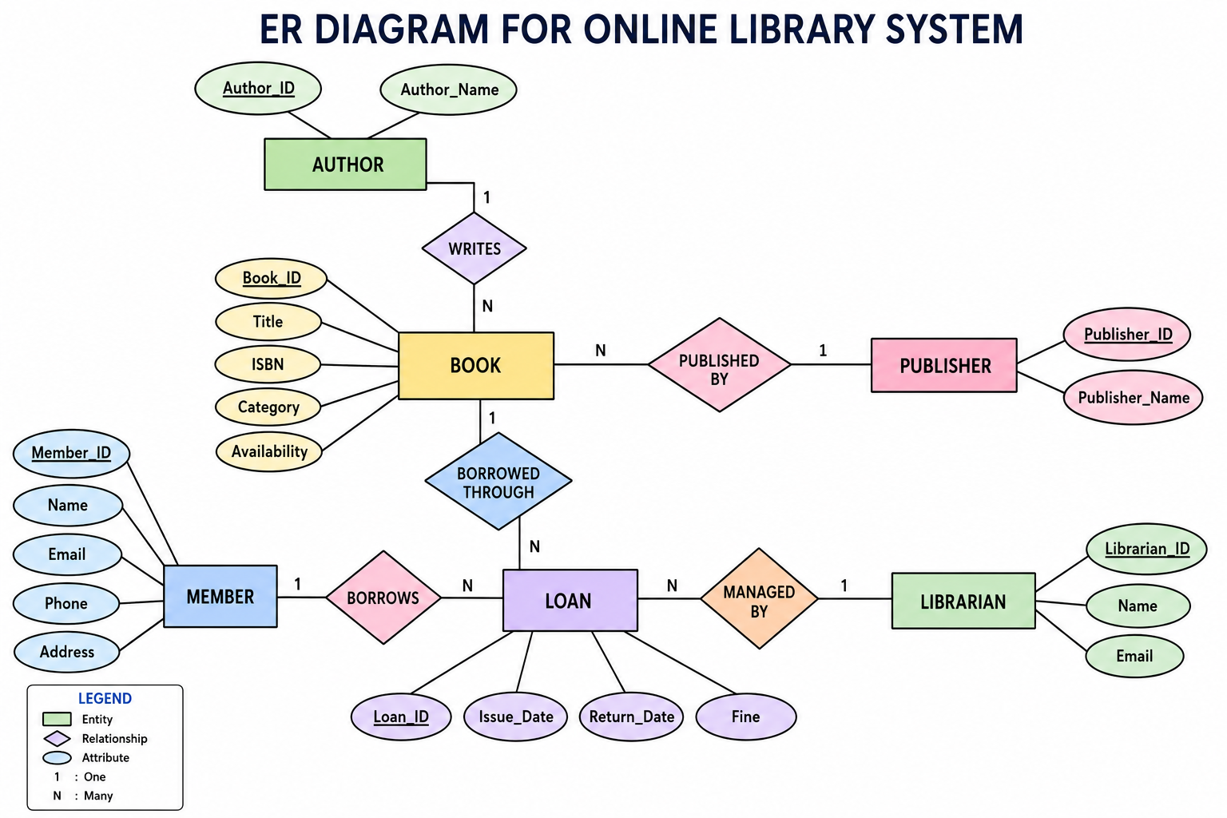
ER Diagram

Slide 12
Explanation of Components
Book
Stores book details.
Member
Stores registered users.
Loan
Tracks borrowing history.
Author
Stores author information.
Publisher
Stores publisher details.
Librarian
Manages library operations

Slide 13
Advantages
Organized database structure.
Easy data retrieval.
Reduces redundancy.
Improves data consistency.
Simplifies maintenance

Slide 14
Applications
School Libraries
College Libraries
Public Libraries
Digital Libraries
Research Libraries

Slide 15
Conclusion
ER diagrams simplify database design.
Clearly define entities and relationships.
Improve library management efficiency.
Provide a strong foundation for database implementation.

Slide 16
THANK YOU

